Slide 1
The Art of Asking Questions
With Shane Gibson
Professional Speaker & Author
@ShaneGibson

Slide 2
“Selling…
…is about creating an environment where an act of faith can take place”

Slide 3
“You can’t control the customer or prospect but you can control the process.”

Slide 4
Sales Process ROI
“We discovered that sales forces were most effective at managing their sales pipelines if they had invested time in defining a credible, formalized sales process.
In fact, there was an 18% difference in revenue growth between companies that defined a formal sales process and companies that didn’t.”
– Harvard Business Review (Jason Jordan Jan 21 2015)

Slide 5
3 Sales Process Success Indicators
Quality and consistency of lead flow
Quality and depth of conversations
Quality and tenacity of follow-up

Slide 6
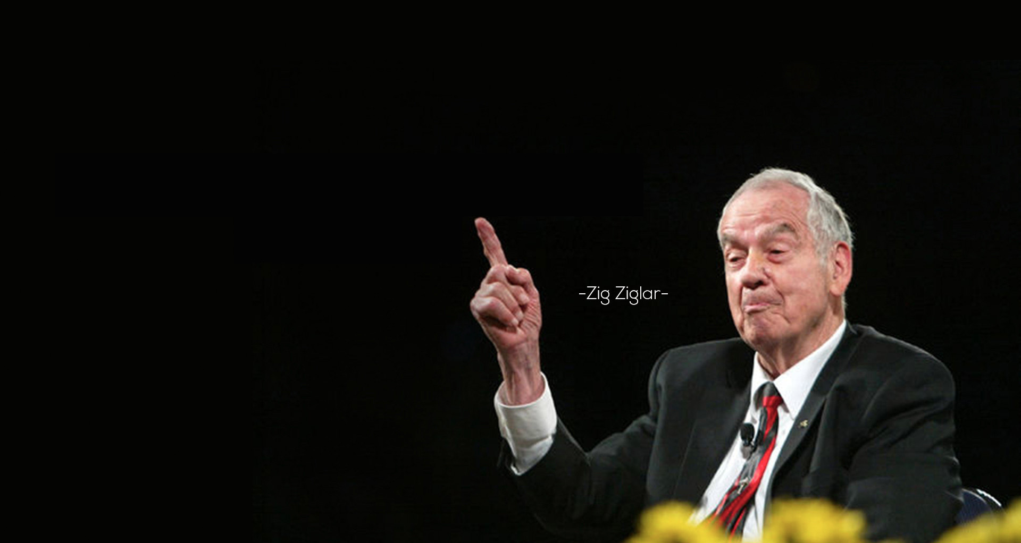
“I’ve heard many people talk their way out of a sale but I have heard very few listen their way out of a sale.”

Slide 7
Most people don’t listen, they just wait for their turn to talk.

Slide 8
70/30 Selling

Slide 9
Needs Analysis
Forces you to listen
Shows real interest
Nothing is missed
Is a record
Free education
Leads the customer

Slide 10
Would it help to know the clients’:
?
Likes
Dislikes
Fears
Beliefs
Problems
Achievements
Challenges
Objectives
Values
Goals
Motivations
Dreams

Slide 11
20 % of your questions provide vital information, 80% build rapport and lead the customer.

Slide 12
General Standard Easy Questions
More focused that begin to tell a story
Confidential
Financial
Needs
Analysis
Questionnaire

Slide 13
3 Rules
Never sell during the needs analysis
Watch their tone and body language
Watch your tone and body language

Slide 14
Effectiveness Levels of the Various Aspects of Communication
7% is in the words
23% is in the Tone of Voice
35% is in the Facial Expression
35% is in the Body Language

Slide 15
Mirroring

Slide 16
Ways We Can Mirror for Improved Rapport
Eye movements
Gestures and posture
Breathing rates
Tonality
Flow and pace of language
Tempo, tone and format of written communications
“People like to do business and socialize with people who are much like them”

Slide 17
Emotion Creates Motion
Motion Creates Emotion

Slide 19
“Testosterone is one key chemical for "power." The other is cortisol. When cortisol levels drop, people are better able to handle stressful situations (a good thing in a leader). After the 2-minute poses, the cortisol levels of the "high power" group fell sharply. The cortisol levels of the "low-power" group, meanwhile, rose.” - Amy Cuddy

Slide 20
Fake it to you make it Model it until you become it

Slide 21
Building Bridges - Building Rapport

Slide 22
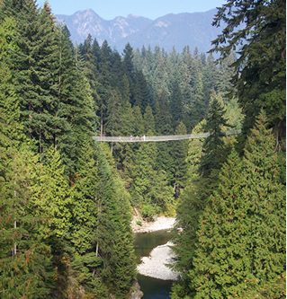
Building Bridges – Building Rapport
Empower yourself
Take time to break the ice
Drop the traditional roles
Monitor your body language
Match / Mirror / Pace
Use understandable language
Story telling
Listening through clarification
(Listen to understand not just to respond)

Slide 23
Varied Questions Create Contrast
Open
Closed
Leading
Requests

Slide 24
Open Questions
Tell me about the type of builds you have been working on lately ?
What kind of colour scheme and accents have you been considering?
What is your present process for finding good trades?
What made you decide to look at our company?
In order for this to work for you, what has to happen?
What is your focus for the next 12-18 months?

Slide 25
Closed questions
Do you have a mason you work with on these types of projects?
What is the start date for the project?
Are you looking at other options?
Do you have any other projects like this coming up?
When do you need delivery?
Has the designer spec’ed the exterior yet?

Slide 26
Leading questions
What made you go with _________ for those projects?
Would a pool be an option if you could reduce lead times?
Were they easy to work with?
Is having someone local important to you?
Is it important to have a supplier that can quickly scale orders to keep up with your business growth?
Have delivery delays added a lot of carrying costs for your last couple projects?

Slide 27
Requests
Tell me… where are you in your decision making process now?
What is your process for determining what supplier you will partner with?
What do you like most about _______?

Slide 28
3 Vital Questions
Have I missed anything?
Do you have any questions for me?
Based upon what you have shared with me, would you mind if I shared with you how I think we could help you?

Slide 29
Passive Phrases
Do you think this will be a good option for you?
Do you like ___________ ?
When would be a good time to meet?
I’m just touching base…
It’s just ___________ from K2 Stone calling.
Would you like a tour of our showroom?

Slide 30
Proactive Phrases
“What do you like about what you have seen so far?”
“Did you prefer the _________, ____________, or ____________ ?”
“I can drop by on Monday at 3 pm or Friday at 10:00 am, which one works for you?”
“I’m calling because (observation of need) and I wanted to let you know about (need or unique opportunity you can fill with your solution).” “Let me take you on a quick tour.”

Slide 31
Design your own needs analysis
Brainstorm multiple open, closed, leading and request type questions
Rate them from least to most confidential
Pick your top 5-7
Practice out loud to test comfort and flow

Slide 32
Prospecting
The continual search for past, present and potential clients that are ready, willing and able to purchase what you sell.

Slide 33
Prospecting is a…
Mind-set
Discipline
Life skill
Sense of expectant, positive curiosity

Slide 34
CCIC
Comment
Compliment
Introduce
Commonality

Slide 35
Network Prospecting
Your Association, Activity and Club Contacts
Community contacts
Neighborhood Contacts
Your Personal Suppliers
Your Business/Industry Associates
Existing Clients
Your events, lunch and learns etc.

Slide 36
Investigative Prospecting Sources
Names from Conversations
Association Directories
Membership Lists
Branded signage
Site signage
Success Stories
Print
Radio
TV
Local websites
Press sites
Development/Reno applications

Slide 37
Lead & Referral Sources
Professional Associations
Chamber of Commerce
Exhibitions/Conventions/ Trade Shows
Mortgage Brokers
Masons
Architects
Landscapers
Government Departments
Industry Magazines
Existing Clients (Happy)
Trade Publications / sites
Bankers
Realtors
Who else?
Immigration consultants

Slide 38
Internet - Prospecting and Networking
LinkedIn
Blog Commenters
Press Releases
Industry Portals
Facebook
Instagran
Google Alerts
Twitter
Meetup.com
Chamber and Association directories
Other social networking sites…

Slide 40
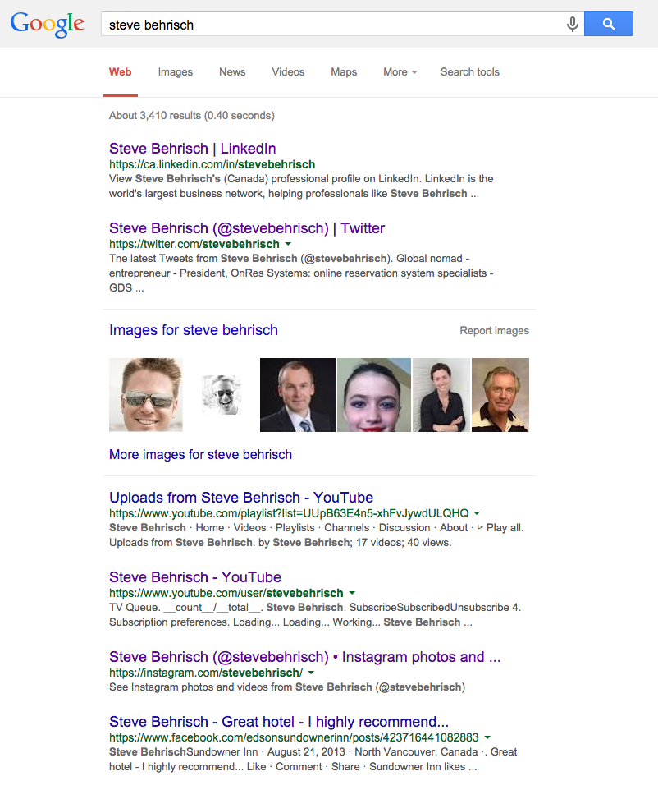
Steve Behrische’s Social Graph
onressystems.com

Slide 41
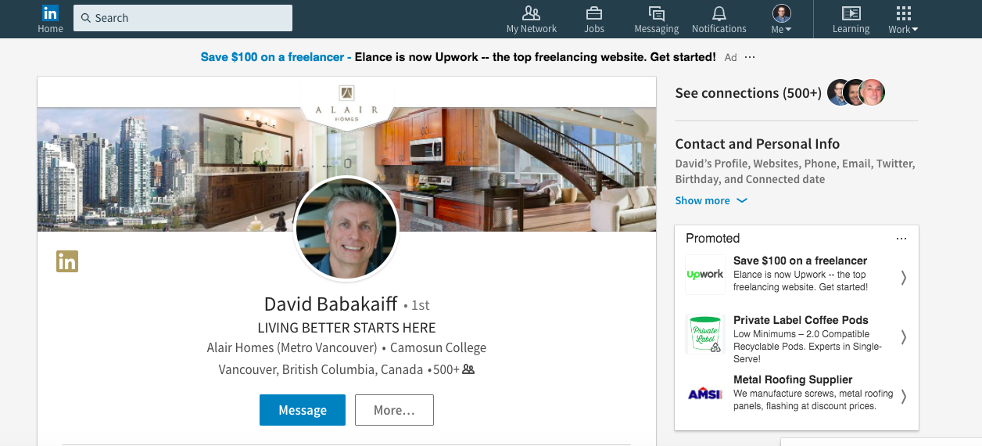

Slide 43
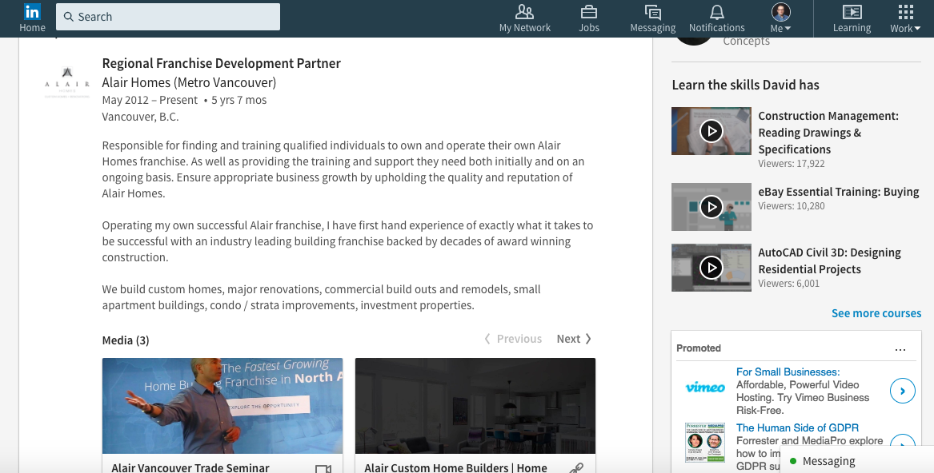

Slide 44
Social
Proximity

Slide 45
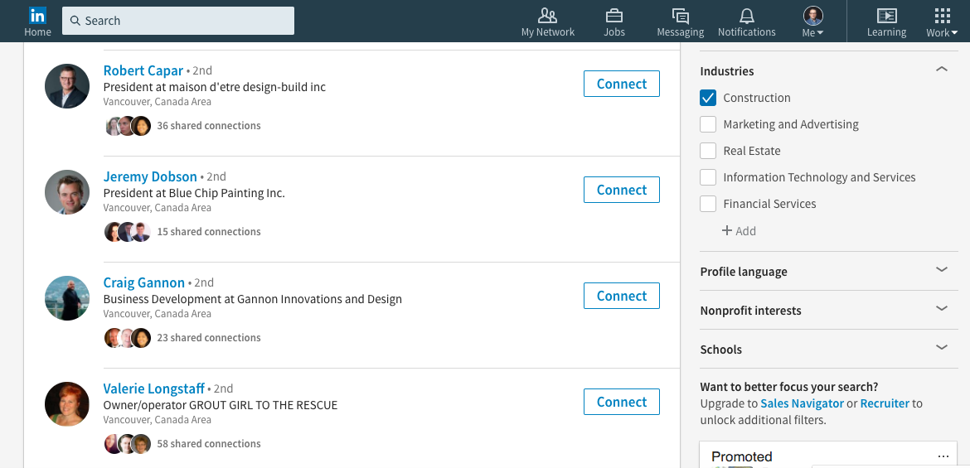

Slide 46
My Funnel Sources Q1
Board of Trade/Chamber of Commerce, Distinguished Speaker Events, Luncheons
Guest Speaking
UBC Events
Terminal City Club, Marine Clubs, Rowing Club etc.
Business Coaches
CRM Partnerships
Lunch with my network
Social Engagement Online
BIA’s
Local MLA/MP Events
BCTIA
Scotch and Craft Beer and Wine Festivals (my favorite)
Volunteer for A category charity or community events
Shane’s VIP mixer
Sales Performance Forum
Shapr
LinkedIn leads daily

Slide 47
Nurtured Leads
“Nurtured leads make 47% larger purchases than non-nurtured leads.”
– Annuitas Group
According to Forrester Research, companies that excel at lead nurturing generate 50% more sales leads at 33% lower cost per lead.
- DemandGen Report

Slide 48
“80 percent of prospects that don’t make the grade today will go on to buy from someone within the next 24 months.”
- SiriusDecisons

Slide 49
Touches
In-person meeting
Social Get-together
Phone Call
Lunch / Dinner
Coffee
Handwritten cards
Networking event
Conference
Personal email
Hangouts / Skype
Text
Team member contact
Swag / gifts
Business intelligence
Tradeshows

Slide 50
Social/Digital Touches
Twitter interaction / question
LinkedIn connection, comment, like, message
Facebook like, comment, message
Forward relevant blog
Whitepaper / Case studies
Sharing their content
Email / newsletter
Video message

